Slide 1
Strengthening Justice
&
Emerging Justice
Pre application webinar
14 July 2026

Slide 2
Pre Application Webinar
14th July 2026, 2.30 – 3.30
Panel:
Rachael Takens-Milne, Director of Grants and Learning
Ali McGinley, Head of Grants
Anna Bear, Communications Manager

Slide 3
Welcome and plan for the session
LEF’s grantmaking
Strengthening Justice fund
Emerging Justice fund
Our grants in numbers
Key criteria: accountability to communities and using or shaping the law for change
What else we look for and what we don’t fund
Application process and decision making
Q&A

Slide 4
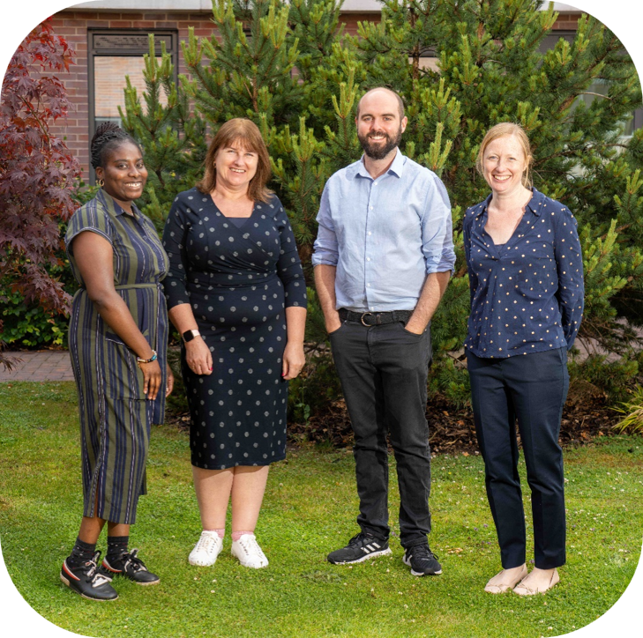
LEF’s grantmaking
We want to create new connections between the law and communities facing injustice.
We are looking to fund organisations that:
      prioritise accountability to their communities
      use and shape the law (or want to) to influence wider change.
We have two funds within our open grant programme:
      Emerging Justice
      Strengthening Justice
Power, culture and inclusion

Slide 5
Our grants programmes
Emerging Justice fund
Strengthening Justice fund

Slide 6
Emerging Justice fund
  Two strands of funding, both for ‘by and for’ organisations working on human rights and equality issues – who would like to either explore how to add legal tools or a legal approach to their campaigning or change work, or test these methods out over a longer term.
  Scoping grants: short term or exploratory work for those who haven’t used the law before, for example to:
    Find a legal partner
    Work with a law firm to develop a legal strategy
    Understand the law relevant to your campaign and identify potential changes and opportunities to influence
    Funding of up to £50k (max), for up to 12 months
    Decisions rolling (up to 14 weeks).
  Multi year grants: Funding for up to three years to test or further develop legal work, for example:
    Using the law for change e.g. complaints to ombudsmen or public sector equality duty challenges to hold institutions to account or using evidence from FOI requests to challenge poor practice.
    Influencing draft legislation on your campaign issue to improve the law.
    Contributing to strategic litigation by supporting or intervening in a case to establish better protections for your community
    We can offer £50-£75k per year but we will not normally fund more than 50% of your organisation’s annual income.
    Decisions are made twice a year.

Slide 7
Emerging Justice fund: examples
  Scoping/small grants:
  A ‘by and for’ organisation working to address the discrimination faced by people with experience of the criminal legal system. The grant enables them to work with a human rights lawyer to identify how using the law might help achieve their influencing goals.
  A DDPO campaigning for the rights and entitlements of Disabled people. The grant provides them the scope to work with a law firm to explore how they might leverage the Equality Act 2010 in their work to tackle discrimination.
  Multi year grants:
  A black-led racial justice organisation working to dismantle systemic racial inequality through pre litigation work, research and policy. The grant will help them build on this work by exploring strategic cases for litigation.
  A community organisation of Black and racialised women survivors of domestic and sexual violence, which had started working with a law firm to strengthen advocacy for their clients. The grant provides them capacity to develop this work more systematically to strengthen their wider influencing work.

Slide 8
Strengthening Justice fund
This fund aims to connect organisations already using and shaping the law more closely with communities facing injustice and to create the space for these organisations to respond to emerging opportunities and challenges.
We will consider:
    How accountable your organisation is to the communities you serve.
    How your organisation uses or shapes the law to drive wider change.
Funding is via flexible grants of £50k-£100k per year over 3-5 years to support your work related to the law.
We will not normally fund more than 35% of your organisation’s annual income.
Decisions are made twice a year

Slide 9
Strengthening Justice fund: examples
  Multi year grants (all 3 years):
  Member-led organisation working to hold the government to account and campaigning for public accountability and scrutiny through legal change
  Organisation using and reforming the law to secure human rights protections for survivors of human trafficking, slavery and exploitation
  Legal organisation working alongside grassroots groups to support communities in identifying and using legal tools to address issues they prioritise.
  By and for women’s rights organisation working to address the gap in protection for migrant women who have experienced domestic or sexual violence

Slide 10
Our grants in numbers
    Awarded £8.2m in our first year of these new programmes (Autumn 2025 and Spring 2026)
    Strengthening Justice:
      33 grants
      Success rate 31%
      Average grant size £206k.
    Emerging Justice multi-year:
      7 grants
      Success rate 18%
      Average grant size £165.6k
    Emerging Justice scoping grants:
      7 grants
      Success rate 23%
      Average grant size £34k

Slide 11
Accountability to Communities: what we look for
  Accountability is not a fixed destination: we are interested in where you are on the journey
  For Emerging Justice:
    Both the multi year grants and the scoping grants are specifically for 'by and for' organisations
  For Strengthening Justice, we are looking for:
    Organisations that can critically reflect with honesty on strengths and areas they want to improve
    We are interested in where the power lies. Are communities consulted, or do they have a real influence over the priorities, strategy and direction of the work?
  Funded organisations had developed a range of creative and meaningful ways to ensure communities shape priorities and decisions
  This may include lived experience representation– but is a wider approach to building or sharing power and including those voices that are often missing from decision making.

Slide 12
Using and shaping the law for change: what we look for
  Variety of legal tools and approaches used alongside organising, campaigning and advocacy for wider change
  Law can be used to hold institutions to account, influence legislation, challenge discrimination, increase transparency, strengthen rights, support strategic litigation, contribute to public inquiries or build evidence for change
  Strongest applicants told us how their chosen legal tool or approach contributed to a strategy for change and where power was shared with communities

Slide 13
Applications and decisions

Slide 14
What else we look for
  We prioritise small and medium-sized organisations (usually under £2m annual income) undertaking charitable work in the UK.
  We will take your context into consideration, including opportunities for influence, number and/or geographical spread of people impacted by the issue and who else may be already working on it.
  We want to promote solidarity between different groups of people facing injustice.

Slide 15
Eligibility and exclusions
  We do not fund work on criminal law – e.g. the creation of new offences – we do fund work which focuses on discrimination in the criminal legal system.
  We fund work to strengthen migrants’ rights but our support for access to justice in the immigration system is channelled through the funder collaboration, Justice Together, and training new immigration lawyers through the Justice First Fellowship.
  We do not fund projects to develop or manage pro bono legal advice.
  We do not replace or subsidise government, legal profession or university funding including the costs of law clinics.
  LEF funds organisations not individuals. Organisations do not need to be charities or companies but they need a structure and access to a bank account with two signatories.
  We are unlikely to fund organisations:
  That have not previously received funding or where we would be this organisation's first grant.
  Are in serious financial deficit
  Have more general reserves than in their policy
  Have fewer than three Trustees, Directors or Committee members.
  Are based outside the UK.
  The full list is on our website.

Slide 16
How to apply
  We encourage you to take our short quiz on the application portal.
  Register on our portal.
  Choose how to apply:
  By answering our questions online.
  By sharing video or other online content.
  By uploading documents such as an application to another funder.
  If they are not already publicly available, please send us your governing document and most recent accounts.
  You can apply at any time.
  If you need help with your application:
  You can book a short guidance call with the grants team through the portal or via the contact form on our website.
  Word and PDF versions of the application form and funding guidelines are available on our website.
  There will be an Easy Read version of the funding guidelines.
  Access payments are available for Deaf, disabled and neurodivergent people to help with applying.

Slide 17
What happens next?
  The grants team assess which applications best fit our criteria.
  For Emerging Justice short-term grants (under £50k), the grants team will make a collective decision on the applications. You will hear within 12-14 weeks.
  For all applications over £50k, the grants team makes a collective decision about which applications are strongest within the available budget. You will hear within 5 weeks.
  If your application is shortlisted, a member of the grants team will visit you or meet you online.
  We will ask for financial information about the current year at second stage e.g. organisational budget
  There is no second stage application form. But, if you did not complete our application questions at first stage, we will work with you to complete these at second stage. This is so our Grants Committee has equivalent information to consider.
  All shortlisted applications are considered by our Grants Committee, which makes the final decision. This is made up of 3 LEF Trustees and 3 external members with lived and learned experience of the issues on which we fund.
  All unsuccessful applicants are told the reason(s) for our decision. This is more detailed at second stage but everyone can request additional feedback.

Slide 18
Key dates
You can speak to us and apply at any time but, for applications over £50,000, we have two decision points each year. For Autumn 2026, these are the key dates:
Until 11 September Application guidance calls available with the grants team.
17 September Last date for submitted applications to be considered in autumn round
End of October Notification of first-stage decisions
October-November Second stage assessments (visits/meetings)
End of December Notification of final decisions

Slide 19
Thank you
LEF
15 Alfred Place
London WC1E 7EB
lef.org.uk

