Slide 1

Charity Campaigning in the lead up to the Senedd and English local elections and Campaigning Frameworks
28th January 2026

Slide 2
Charity Campaigning in the lead up to the Senedd and English local elections – May 2026
Summary of Talk
Charity Rules on campaigning
Holding hustings
Election law* for non-party campaigners: Political Parties, Elections and Referendums Act 2000 (‘PPERA’): General Elections, devolved authorities and referendums. (Note: the Representation of the People Act 1983, covers local campaigns for or against one or more candidates in constituency, ward or other electoral area).
Regulated period for a the Welsh Senedd Elections is 4 months from 7 January 2026 to polling day on 7 May 2026.
Representation of the People Act 1983 covers Local Elections - campaigns for or against one or more candidates in constituency, ward or other electoral area. Spending limits apply from when a local candidate declares, or 30 March 2026 at the latest. Charities should not be incurring regulated spending in this area.
Tips for Campaigning to Avoid Registration with the Electoral Commission.

Slide 3

Charity Commission CC9
‘Campaigning ‘activities can be a highly effective means of pursuing a charitable purpose, even where the matters at issue are controversial. Charities have a vital role to play in society in promoting the interests of their beneficiaries and in contributing to public debate.’

Slide 4
Summary of relevant Charity Commission Guidance
Charity Commission Guidance CC9
Charity Commission Supplementary Election and Referendum Guidance
Charity Commission 5-Minute Guide (October 2022)
Annual Return Question (2025) on whether a charity has a Policy on ‘Campaigns and Political Activity and Procedures’.
Charity Commission Social Media Guidance, September 2023
Guidance update on charities and political donations (November 2022)
Note in relation to the Scottish Parliament elections, not covered by this webinar:
Where charities have cross border registration with OSCR in Scotland the requirements for that jurisdiction will need to be considered.

Slide 5
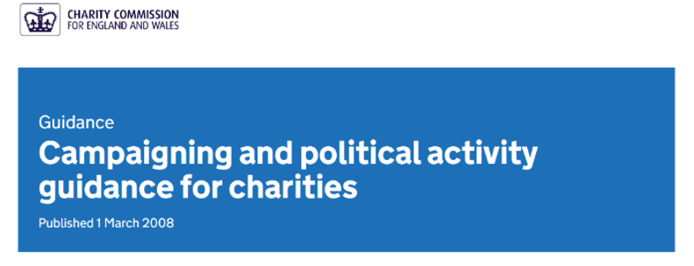
Definition of Lawful Charity Campaigning
A charity must advance charitable purposes and must exist for the public benefit
A charity cannot have a political purpose.
Two types of lawful campaigning: Speaking Out- Campaigning and Political Activity by Charities, CC9
Non-Political Campaigning and Political Campaigning
Charity Objects
Recording Decisions
A Charity must not give support or funding to a political party, nor to a candidate or politician. The prohibition on support for a political party, politician or candidate includes a trading subsidiary of a charity.

Slide 6

Elections: Can Charities Continue to Campaign in the Run Up to an Election?
Charities can continue to campaign subject to the Charity Commission’s ‘Charities, Elections and Referendums’ supplementary guidance, election law, specific requirements in a charity’s constitution or restrictions laid down by funders.
The Charity Commission’s supplementary guidance does not cover election law (as opposed to the charity law requirements) and depending on the content, tone and timing, some of the permitted activities may have regulated electoral consequences

Slide 7

Charity Commission Supplementary Advice on Elections
Where a charity’s policy position coincides with or is similar to a political party, it can continue campaigning on this issue, as long as it maintains its independence. A charity must not explicitly compare its views with political parties or candidates.
The Charity Commission gives this example:
‘If a housing charity supports the building of 100,000 new homes, it can outline the housing policies of each party, including how many new homes each party is committed to building, but it must not explicitly call on people to vote for one party or another.’
It should be noted that publicly comparing policy positions may be regulated activity for election law (but see later) as follows:
Electoral Commission Overview of Non-Party Campaigning
In relation to electoral law, it is likely that comparing policy positions of parties against policies which are expressly approved by your charity could be reasonably be intended (at least in part) to promote the electoral success of partiers advocating the charity’s approved policies.

Slide 8
Charity Commission Guidance on Elections
In almost all cases, an activity will meet the purpose test if it:
identifies political parties or candidates who support or do not support your campaign’s aims
sets out or compares the position of political parties or candidates on a policy you are promoting in a way that can reasonably be regarded as intended to influence voters to vote for or against particular parties or candidates
promotes or opposes policies which are closely and publicly associated with a party or parties or with categories of candidate that it is reasonable to regard your campaign activity as intended to influence voters to vote for or against political parties or candidates
A charity may publish the views of candidates in local and national elections where these views relate to the charity’s purposes and publishing them will raise public interest and debate about the underlying issues, but it must not encourage support for a particular party or political candidate.

Slide 9

Charity Commission Supplementary Guidance on Elections (Continued)
A charity cannot appear in a political party’s manifesto. A charity can publish its own manifesto to persuade political parties to adopt their policies.
A charity can ask a candidate for their views on the charity’s policies e.g., to seek a pledge regarding a particular issue, such as building new houses, or climate change.
If the pledge is publicised prior to the election, this is likely to be regulated activity under election law.
Risk assess if a charity employee is a candidate and to make sure that charity channels are not used to promote personal political views or to support or retweet party political content.

Slide 10

Hustings
You can invite candidates to an event or hustings.
But take great care regarding any exclusions. The charity must not inadvertently give support to or prejudice a candidate.
The hustings may be regulated under electoral law if they are ‘selective’, with exclusions not made for an impartial reason.

Slide 11
Hustings (continued)
The Electoral Commission has specific guidance online on hustings and provides examples of impartial reasons for not inviting a candidate or party:
  Resource or other practical constraints
  Security concerns
  Local prominence of some parties over others
  The number of elected representatives at the local or national level or recent election results in the area
Charities should consider national and local prior results and polling in this assessment, as well as changes to the electoral system for the Senedd elections.
Difficulties may arise where parties advocate policy positions contrary to those of the charity – this is unlikely to be an impartial reason.

Slide 12
Election Law
Political Parties, Elections and Referendums Act 2000 (‘PPERA), as amended by the ‘Lobbying Act’ 2014 and the Election Act 2022.
Applies during the regulated period before an election, regulated by the Electoral Commission and concerns ‘non-party campaigns [for or against a political party], policy, issue or a particular type of candidate’.
Regulated period for a the Welsh Senedd Elections is 4 months from 7 January 2026 to polling day on 7 May 2026.
--Representation of the People Act 1983 covers Local Elections - campaigns for or against one or more candidates in constituency, ward or other electoral area. Spending limits apply from when a local candidate declares, or 30 March 2026 at the latest. Charities should not be incurring regulated spending in this area.

Slide 13

Controlled Expenditure
For the Senedd elections in relation to regulated campaign activities, any UK-based charity, subject to charity law, can spend up to £10,000 on regulated activities without having to register with the Electoral Commission.
Spending on activities meeting the purpose, public and activity tests is caught (explained further later).
Registered non-party campaigners may spend up to £30,000 as an upper limit. We assume most charities will wish to avoid formal registration.
Specific Electoral Commission guidance for non-party campaigners at the Senedd Elections.
The spending thresholds for local campaigning at Local Elections are very low and depend on the size of the relevant area: £50 + 0.5p per elector in the ward. But charities will not be engaging in controlled spending in this area.
There is no regulated period for general campaigning at Local Elections (campaigning for against a party or category of candidates, e.g. those supporting a particular policy)

Slide 14
Election Law (Continued)
  Many charities do not wish to register because there is a heavy burden of compliance including keeping invoices, monitoring and reporting spending as well as controls on donations. Must be a Responsible Person.
  Technical non-compliance: for example, not keeping an invoice, not paying an invoice on time, not using a printed and/or digital imprint in exactly the right format, may lead the Electoral Commission, in some circumstances, to sanction or levy a fine.
  Importantly, the current Electoral Commission guidance states that while charities can and do carry out regulated activities and that a handful registered with the Electoral Commission in relation to previous General Elections:
  ‘if you are a charity and abide by charity law and guidance from the relevant regulator in most circumstances your campaign activity is unlikely to meet the purpose test’.
  However, a charity still needs to be aware of the non-party campaigner rules in case your activities pass the purpose test.

Slide 15
How is expenditure caught by PPERA?
The PURPOSE TEST: Spending on activities and that can:
“reasonably be regarded as intended to promote or procure electoral success at any relevant election for:-
One or more particular registered parties (A charity is not permitted to do this);
One or more registered parties who advocate [or do not advocate] particular policies or who otherwise fall within a particular category of such parties, or
Candidates who hold [or do not hold] particular opinions of who advocate [or do not advocate] particular policies or who otherwise fall within a particular category of candidates” (PPERA s85(2))
Includes prejudicing electoral prospects of one party
Immaterial if campaign can be seen to reasonably achieve any other purpose as well.
EC guidance: consider tone, timing & whether there is a call to action to voters

Slide 16


Purpose Test continued
  It should be noted that the test is not whether a charity’s actual intention is to change the voting intentions of electors, but where its campaigning can be reasonably regarded as intended to promote or procure electoral success.
  In many cases, changing certain facts or the timing of a Campaign, sometimes just by a little, could increase or decrease the risk - which is why in terms of the facts and the circumstances, the analysis ultimately has to be conducted in ‘real’ time.
  For example, a campaign may not have significant traction or immediate public recognition, but could in the course of campaigning become a high-profile issue used by political parties, candidates, the media or others to highlight major differences between political parties or candidates.
  The test must be applied at the time of the campaigning as the analysis relies not just on the tone of the non-party’s communication, but on external variables such as the salience of the issue and the policy positions of parties and candidates.

Slide 17
Analysing your charity’s activities – charity and electoral law
Content of your charity’s campaign - it is not necessary to name a political candidate or political party for the Purpose test to be passed:
Timing of your charity’s campaign - will a public facing campaign be run close to the election?
Tone - for example, does the material use disparaging treatment or language, not aimed at developing an audience’s understanding of an issue? Or does the material cast a category of candidate or type of policy in a positive light? Think carefully about language associated with particular parties or candidates.
Consider the material from an outsider’s perspective. Would a reasonable person view the campaign content as helping or hurting the chances for election of any particular political party, candidate or groups of candidates?
Avoid hashtags identified with a party or candidate.
If a political party or candidate adopts your policy, make sure the charity’s independence is maintained.

Slide 18
Purpose Test
When creating campaigning material ask:
Would a reasonable person view the campaign content as helping or hurting the chances for election of any political party, candidate or groups of candidates?

Slide 19
Public Test
Campaign material will only be regulated campaign activity if the material is made available to the public or any section of the public by the non-party campaigner.
Campaign material that is made available to the public or a section of the public
Campaign material that is made available for the public or a section of the public to hear or see will be public and will be regulated campaign activity if it also meets the purpose test and takes place during a regulated period. This applies regardless of the means by which the material is distributed.
Campaign material that is only made available to people who have chosen to receive the information
Campaign material that is only made available by the non-party campaigner to a closed group of members or people who have chosen to receive the information, will not be regulated.

Slide 20
Activity Test
Material made available to the public by whatever means (eg leaflets, adverts, websites, social media, reports etc);
Canvassing, or market research seeking views or information from members of the public;
Press conferences, or other media events, organised by or on behalf of the non- party;
Transport (by any means) of persons to any places with a view to obtaining publicity;
Public rallies or other public events, other than annual conferences of the non-party.
Associated staff time and Expenses eg premises hire, provision of goods, services or facilities.
Key Exception:
Volunteer time

Slide 21


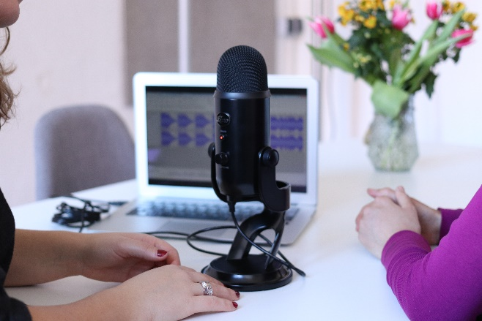
Other exceptions to the public test:
TV adverts, if cleared for broadcast on licenced channels (i.e., not video on demand) will not be caught, as there is a ban on political advertising
Press release only to the media i.e., press release not on organisation’s website or tweeted.
Interviews: BBC, ITV, Sky, local radio, foreign language channel anything licenced under the Broadcasting Act, where there is an obligation of impartiality

Slide 22
Joint Campaigning
If you have a ‘common plan’ with another campaigner, then regulated spending by each campaigner counts towards the regulated spending total for both campaigners.
For example, if organisation A is in a common plan with organisation B and organisation A spends £20,001, organisation B is also deemed to have spent £20,001. Organisation A could register as the Lead Campaigner with the Electoral Commission, but is then responsible for reporting the minor campaigner’s spending.
You are probably in a Common Plan or joint working:
if another campaigner has to approve or can veto your material, you have carved out different areas or medias and are co-ordinating your campaign and spend or you publish joint advertising or leaflets.
You are probably not in a Common Plan or joint working if you:
speak at an event organised by another party, sign a letter and/or advertise your support for the campaign or allow your logo/brand to be used.

Slide 23

What risk mitigations can an organisation put in place to avoid Controlled Expenditure during a Regulated Period?
Influencing activities that exclusively and privately target:
  Members of the Senedd (MSs) and prospective candidates
  National press offices of political parties
  Private meetings with key influencers
  are not caught provided they are private.

Slide 24



What risk mitigations can an organisation put in place to avoid Controlled Expenditure during a Regulated Period?
Commenting on legislation or a policy proposal or strategic litigation
Focus on why the Senedd Bill should become law/views on the policy, rather than on whether particular parties or candidates support or do not support the Bill or policy.
Asking members to lobby to support the Bill, and not imply support for a party or candidate.
  Timing activity to co-inside with Senedd debates on the Bill, rather than continuing to campaign after the Bill has passed into law.

Slide 25


Digital Imprints
  The Election Act 2022 introduced a new requirement around digital imprints. The requirement is that, when certain campaign material is published, it needs to contain certain details to show who is responsible – known as an ‘imprint’ for transparency purposes. Again, this is to ensure and if it is applicable, they apply all the time, like printed imprints and not just in a regulated period that there is transparency for voters about the identity of the individual or organisation campaigning.
  The Electoral Commission has produced Statutory Guidance on imprints that has been laid before Parliament in accordance with Section 54 of the Elections Act 2022. In most circumstances, charities that choose not to register with the Electoral Commission will not be required to use a digital imprint.

Slide 26
Rosamund McCarthy Etherington Tom Murdoch
Stone King LLP Stone King LLP

